Slide 1
Marketing Plan (Unique Marketing Issues)
Chapter 9
References:
Entrepreneurship by Hisrich
Entrepreneurship by Bruce R. Barringer
Marketing Management by Philip Kotler (14th Edition)
Resource Person: Furqan-ul-haq Siddiqui

Slide 2
Understanding the Marketing Plan
Marketing plan - A written statement of marketing objectives, strategies, and activities to be followed in business plan.
Ask yourself these five critical questions:
What is unique about your business idea? What is the general need that your product or service aims to meet?
Who is your target buyer? Who buys your product or service now, and who do you really want to sell to?
Who are your competitors? How can your small business effectively compete in your chosen market?
What positioning message do you want to communicate to your target buyers? How can you position your business or product to let people know about your product?
What is your sales strategy? How will you get your product or service in the hands of your customers?

Slide 3
Selecting a Market and Establishing a Position in the Market
Important Questions That All Start-ups Must Ask
In order to succeed, a new firm must address this important issue: Who are our customers and how will we appeal to them?
A well-managed start-up approaches this query by following a three-step process:
Segmenting the market
Selecting a target market
Establishing a unique position

Slide 4
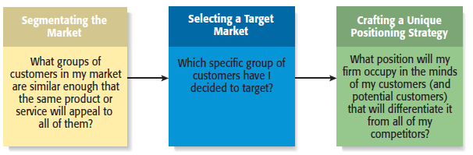
The Process of Selecting a Target Market and Positioning Strategy

Slide 5
Bases for Segmenting Markets
Geographic Segmentation- Dividing a market into different geographical units such as nation, province, regions, countries or cities.
Demographic Segmentation- Dividing the market into groups based on demographic variables such as age, gender, family size, family life cycle, income occupation, education, religion & race.
Psychographic Segmentation- Dividing a market into different psychological/personality traits, life styles, values etc.
Behavioral Segmentation- Dividing a market into groups based on consumer knowledge, attitude etc. includes occasion of purchasing, use rate, loyalty with product & responses.

Slide 6
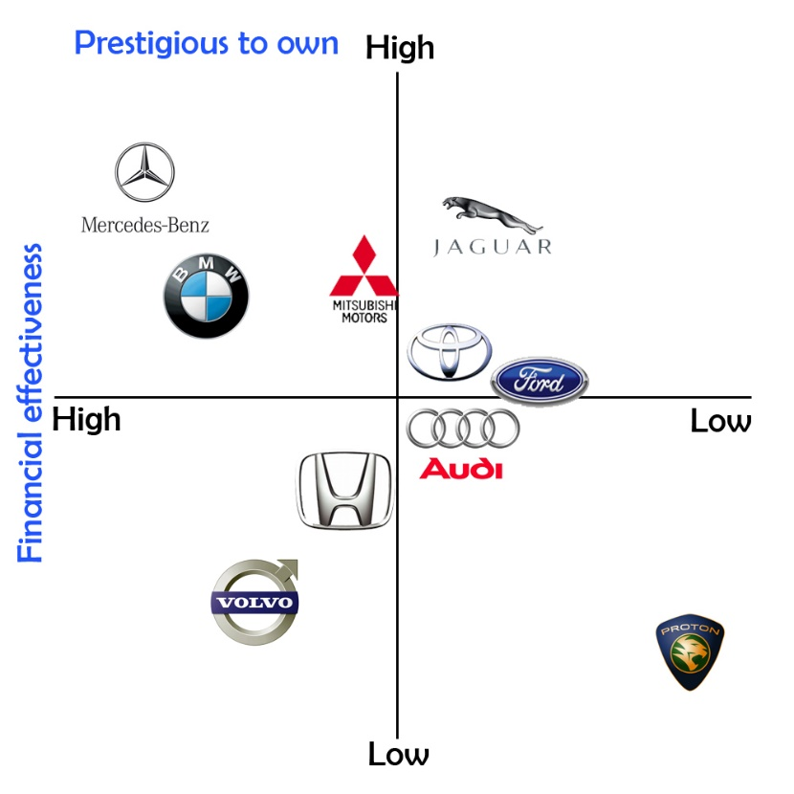
Establishing a Unique Position
A helpful technique is to develop a product attribute map, which illustrates a firm’s positioning strategy relative to its major rivals.
The way by which the marketers attempt to create a distinct impression in the customer's mind.
The positioning concepts focus on the rational or emotional benefits that buyer will receive or feel by using the product/service.

Slide 7
Establishing a Unique Position
Positioning (continued)
Firms often develop a “tagline” to reinforce the position they have staked out in their market, or a phrase that is used consistently in a company’s literature and thus becomes associated with the company.
An example is Nike’s familiar tagline, “Just do it.”
The beauty of this simple three-word expression is that it applies equally to a 21-year-old triathlete and a 65-year-old mall walker.

Slide 8
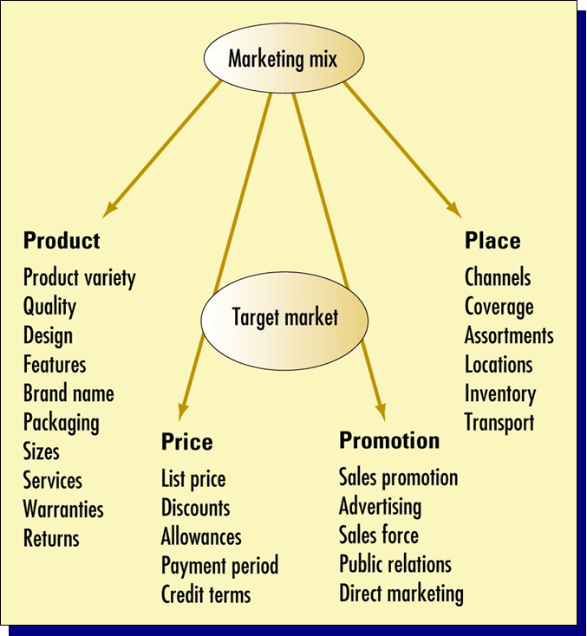
The Four Ps of Marketing for New Ventures
Set of marketing
tools used by a
firm to pursue its marketing objectives in a target market.
Or
Combination of a number of policies
to realize profit through customer satisfaction.

Slide 9
Marketing Mix Variables
Product
Producing goods, services, or any that offering that satisfy customer needs
Pricing
Decisions and actions to establish pricing objectives and policies and set product prices
Place
The ready, convenient, and timely availability of products
Promotion
Activities that inform customers about the organization and its products

Slide 10
Product
May consider more than the physical characteristics.
Involves packaging, brand name, price, warranty, image, service, delivery time, features, style, and even the Web site.
Determining the product or products to be sold is central to the firm’s entire marketing effort. The most important attribute of a product is that it adds value in the minds of its target customers. Let’s think about this by comparing vitamins with pain pills;

Slide 11
Pricing
The amount of money consumers pay to buy a product. It is the only element in the marketing mix that produces revenue; all other elements represent costs. Price is an extremely important element of the marketing mix because it ultimately determines how much money a company can earn.

Slide 12
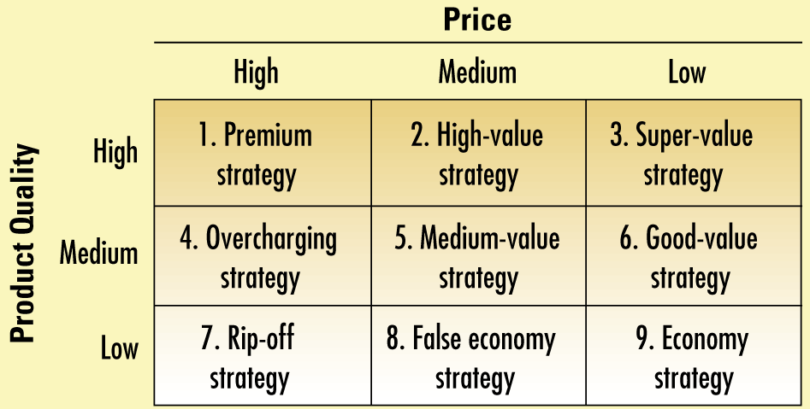
Nine Price-Quality Strategies
Strategies 1,5 & 9 (diagonal) show prices according to quality offered
Strategies 2,3 & 6 to attack the diagonal position
Strategy 4,7 & 8 show overpriced products

Slide 13
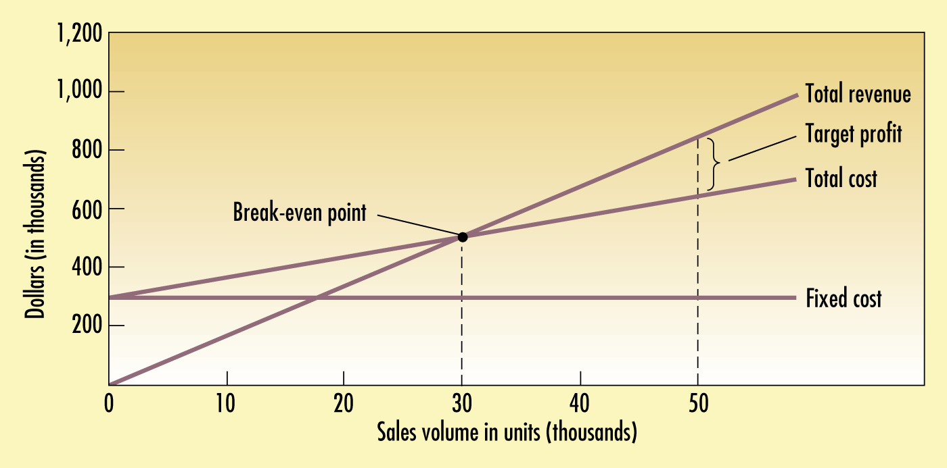
Selecting a Pricing Method
1- Cost-based pricing/ markup pricing: adding a standard markup to the cost of the product; using formula:
Markup price
Markup price= unit cost/ (1 – desired return on sales)
Selling price based on 20%: $16/(1 - .20) = $20
2- Target Return pricing: setting price that would yield its target return on investment (ROI). Eg. A company may select 20% return on its investment
Target-return price= unit cost+ (desired return multiply by invested capital/ unit sales)

Slide 14
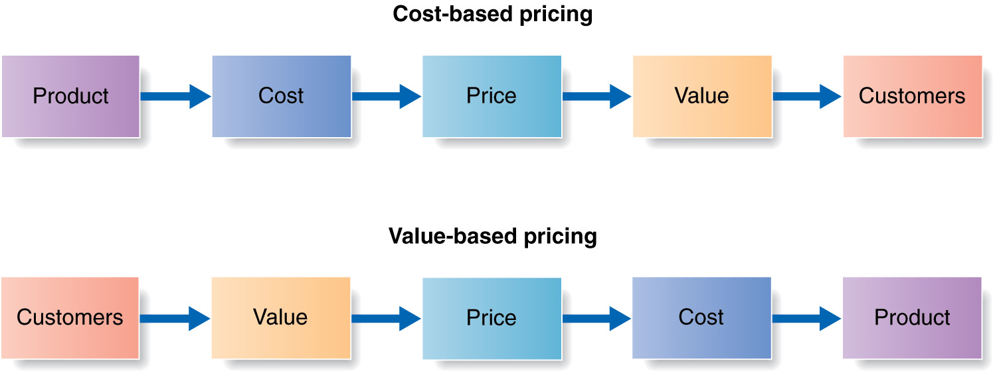
3- Value-based pricing: setting price based on buyers’ perceptions of value rather than on the seller’s cost .
4. Competition based (going-rate) Pricing: Setting prices based on the prices that competitors charge for similar products.

Slide 15
5. English Auction (ascending bids)- Seller announces a starting price and bidder raise the offer price until top price is reached.
6. ODD pricing- many sellers select prices ending with odd number
Theory:$3.00 is rounded to $3.00 while $2.99 is rounded to “$2.00 plus change. according to a 1997 study published in the Marketing Bulletin, approximately 60% of prices in advertising material ended in the digit 9, 30% ended in the digit 5, 7% ended in the digit 0 and the remaining seven digits combined accounted for only slightly over 3% of prices evaluated

Slide 16
Placement
Refers to providing the product at a place which is convenient for consumers to access. Various strategies such as intensive distribution, selective distribution, exclusive distribution, conventional marketing system, vertical marketing system, and franchising can be used by the marketer to complement the other aspects of the marketing mix..

Slide 17
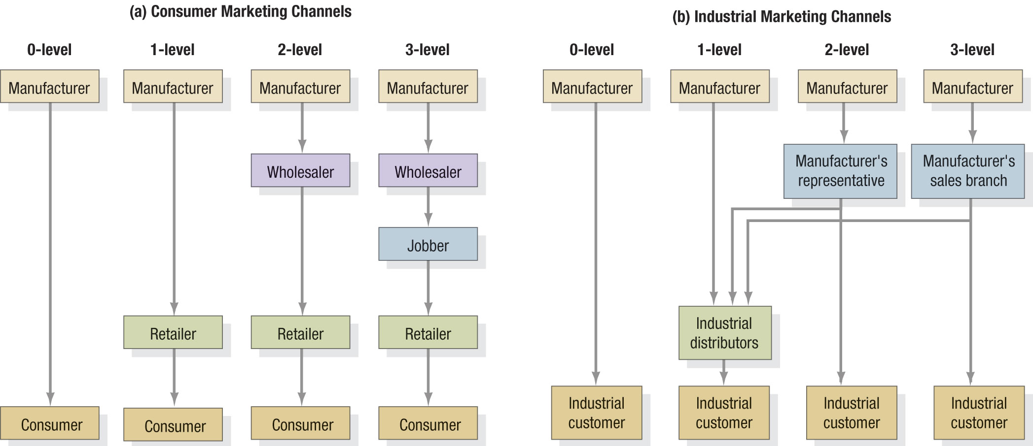
Level of Marketing Channels Channels for Consumer Products
Notes:
The term "jobber" implies a middleman who buys goods from the wholesaler and sells it to the retailer. The principal difference between a jobber and an agent or a broker is that the latter sells goods on another person's behalf while the jobber actually buys the goods himself and then sells to the retailer.

Slide 18
Conventional marketing System- comprises of independent producers, wholesalers or retailers who business just to maximize their own profit even if it reduces profit for a system as a whole. In this there is no control upon any member of channel

Slide 19
Vertical Marketing Channel/system (VMS)
by contrast, comprises the producer, wholesaler, or retailers acting as a unified/coordinated way. The high degree of control and coordination in VMS is achieved through one of the three means:
Corporate VMS: common ownership of successive level of a channel.
Contractual VMS: contracts between independent channel members to increase the efficiency and effectiveness of distribution (franchises etc)
Administrative VMS: Coordination in distribution through market/economic power of one of channel members.
Notes:
The franchiser owns a trade or service mark, and licenses it for use for royalties
Franchisees must pay to be part of the system
Franchisers provide a packaged marketing and operations system

Slide 20
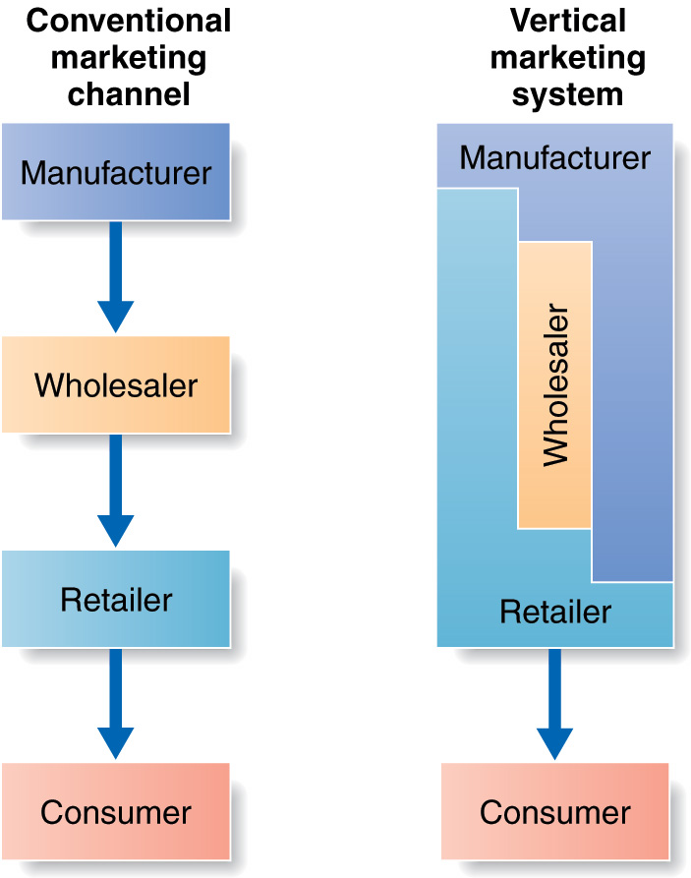
Conventional Versus Vertical Marketing System

Slide 21
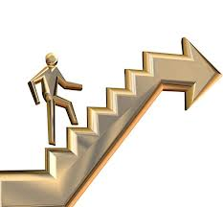

Promotion
General Definition- activity that supports or encourages a cause, venture, or aim.
Promotion refers to the activities the firm takes to communicate the merits of its product to its target market.
Marketing activities to communicate positive, persuasive information about an organization, its products and its activities to a target audience to increase sales & profit of organization.

Slide 22
Advertising
There are five main aspects of a Promotional Mix
Personal Selling
Any Paid Form of Non-personal Presentation by an Identified Sponsor.
Personal Presentations by a Firm’s Sales Force.
Sales Promotion
Short-term Incentives to Encourage Sales.
Building Good Relations with Various Publics by Obtaining Favorable Unpaid Publicity.
Public Relations
Direct Communications With Individuals to Obtain an Immediate Response.
Direct Marketing
Notes:
The Marketing Communications Mix
This CTR relates to the material on pp. 422-423.
Tools of The Marketing Communications Mix
Advertising. Advertising is any paid form of nonpersonal presentation and promotion of ideas, goods, or services by an identified sponsor. Advertising often utilizes mass media and may be adapted to take advantages of a given mediums strengths to convey information.
Sales Promotion. Sales promotions consist of short-term incentives to encourage purchase of sales of a product or service. Limited time offers or dated coupons are common sales promotions.
Public Relations. Public relations is an on-going process of building good relations with the various publics of the company. Key elements in the process are obtaining favorable publicity, building and projecting a good "corporate image," and designing an information support and response team to respond proactively to unfavorable rumors, stories, or events.
Personal Selling. Personal selling describes the use of oral presentations in a conversation with one or more prospective buyers for the purposes of making a sale. Personal selling combines product information and benefits with the interpersonal dynamics of the sales person. Good interpersonal relationship skills and effective oral communication skills are needed for personal selling.
Direct Marketing. Directed communications with carefully targeted individual consumers to obtain an immediate response.

Slide 23
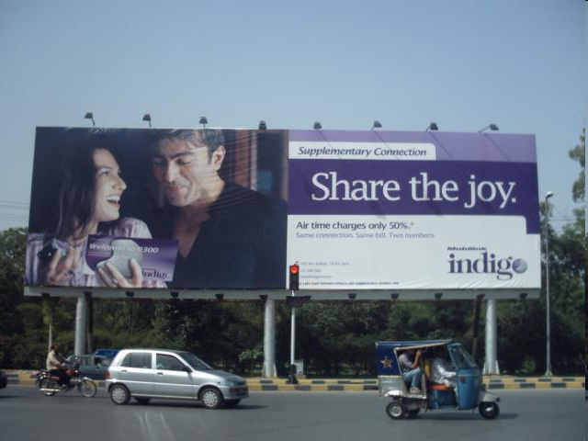

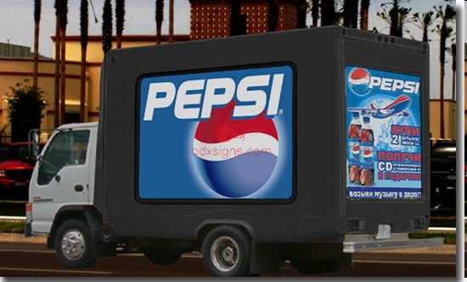
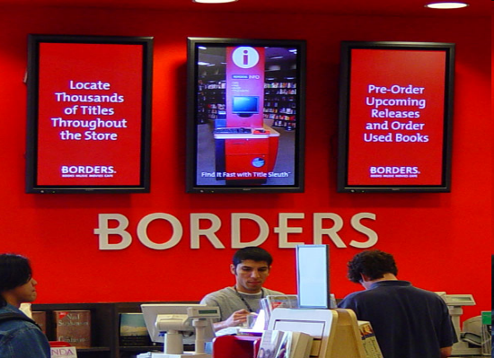
Type of Advertisement
Television
Radio
Print
Online
Billboards
Mobile Billboards
In-store advertising
Infomercials
Covert advertising
Celebrities

Slide 24
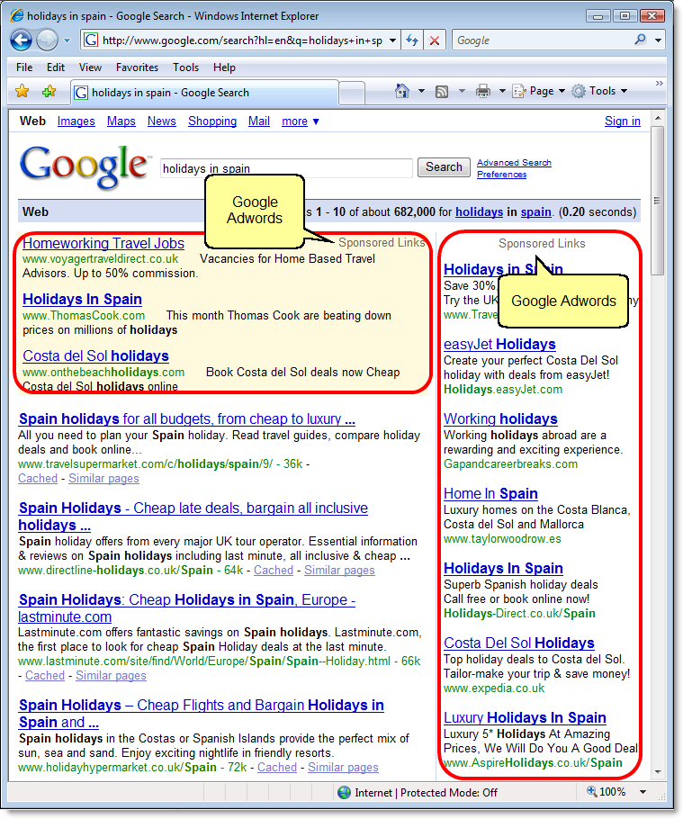
Google Ads and AdSense Program
Google Ads (previously Google AdWords, before July 24, 2018)
Allows advertisers to buy keywords on the Google home page.
Text-based ads to the side of (and sometimes above) search results when the keyword is used.
The program includes local, national, and international distribution.
Advertisers pay a certain amount per click.
AdWords has evolved into Google's main source of revenue. Google's total advertising revenues of USD $95.4 billion in 2017..

Slide 25
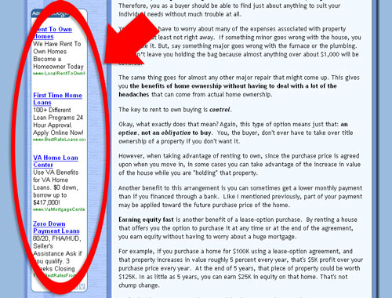
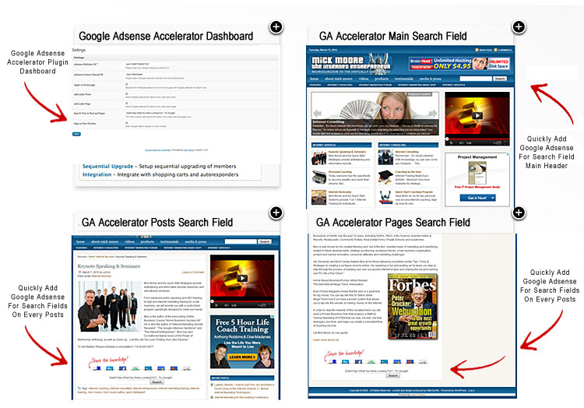
AdSense
Allows advertisers to buy ads that will be shown on other Web sites instead of Google’s home page.
Google selects sites of interest to the advertiser’s customers.
Advertisers are charged on a pay-per-click or a per-thousand impression basis.
Advertisers benefit because the content of the ad is often relevant to the Web site.
Web site owners benefit by using the service to monetize their Web site.
In Q1 2011, Google earned US $2.43 billion ($9.71 billion annualized), or 28% of total revenue, through Google AdSense

Slide 26
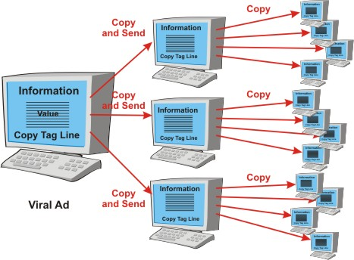
Other Promotions Techniques
Viral Marketing
Facilitates and encourages people to pass along a marketing message about a particular product or service. . (through social media and emails usually by including jokes, games, video clips, etc)

Slide 27
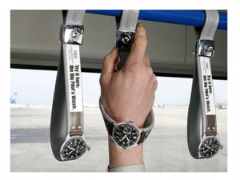
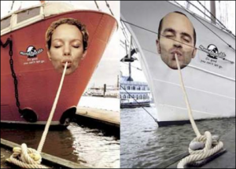
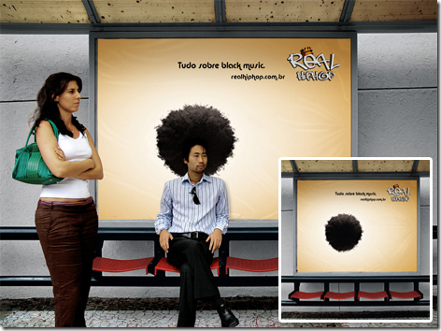
Guerrilla Marketing
An approach to marketing that relies on cleverness, and surprise rather than traditional techniques

Slide 28

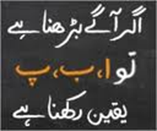
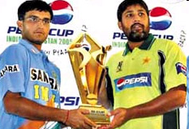
Public Relations
Public Relations
One of the most cost effective ways to increase the awareness of the products of a company is through public relations.
Public relations refer to efforts to establish and maintain a company’s image with the public.
The major difference between public relations and advertising is that public relations is not paid for—directly.

Slide 29
Public Relations Techniques
Press release
Traditional media
coverage
Social media
coverage
Articles in industry
press and periodicals
Blogging
Monthly newsletter
Civic, social, and community
involvement

Slide 30
Social Media
Social Media
Consists primarily of blogging and connecting with customers and others through social networking sites like Facebook and Twitter.
Blogging
The idea behind blogs is that they familiarize people with a business and help build an emotional bond between a business and its customers.
Facebook and Twitter
Businesses establish a presence on Facebook and Twitter to build a community around their products and services.

